Slide 1
jQuery - AJAX (Day 2)
Viktoras Lava www.viktoraslava.lt

Slide 2
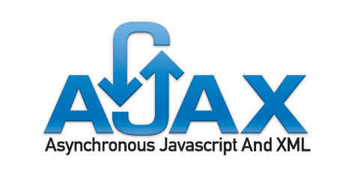
What is AJAX?
AJAX stands for asynchronous Javascript and XML.
$.ajax is probably the method that brought web revolution to life by allowing static website collect dynamic content from other sources
AJAX was created to improve user experience.

Slide 3
Why to use AJAX?
The main use of AJAX is to prevent the need for static pages and move towards dynamic user experience.
With AJAX:
You can see the output without refreshing the page

Slide 4
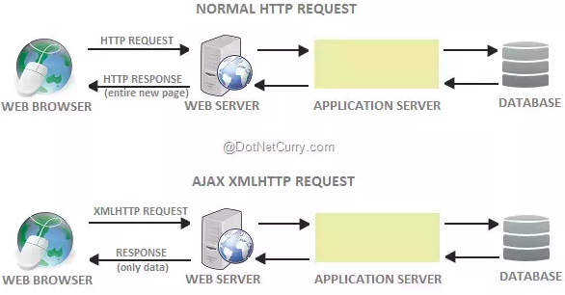
How it works?

Slide 5
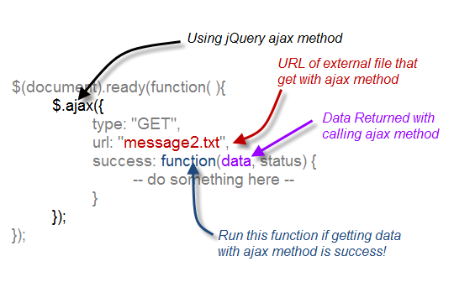
What can we do with AJAX?
Get data from text
Get contents from HTML file
Get contents from XML
Get contents from JSON
Get data from API
Documentation

Slide 6
Questions?

